Slide 1

COIMBATORE INSTITUTE OF TECHNOLOGY
(An Autonomous Institution Affiliated to Anna university)
AUTOMATIC HELMET VIOLATION DETECTION
GUIDED BY :
DR N.K.KARTHIKEYAN,
Department of Information Technology,
Coimbatore Institute Of Technology.
PRESENTED BY:
(1907022 ) LUHINDAAR M
(1907030 ) PRAMOTH KANNA P
(1907057 ) VEDHA B

Slide 2
Agenda :
Introduction
Abstract
Literature Survey
Proposed System
System Architecture
Module Description
Social Impact of the Proposed System
References

Slide 3
Abstract :
In India, the number of accidents occurring each day is increasing rapidly. The two-wheelers account 25 percent of road crash deaths because of ignoring safety measures like wearing helmets while driving. A police officer cannot manage the whole traffic and look out for rule-breakers.
Our project’s main objective is to identify the two-wheeler riders who failed to wear a helmet. The system implements Deep learning and video processing techniques. The system takes a video of traffic on public roads as input.
The road CCTV footage is used to detect whether a rider is wearing a helmet or not, using yolov3 Algorithm, a Deep Learning Technology and the respective frames are taken from the video to detect riders, riding two wheelers, who are not wearing helmets. Using this helmet detection model helmet-less riders can be easily detected.

Slide 4
Introduction :
Bikes are the most utilized mode of transport.
Usage of helmet is recommended to minimize the risk of life.
A real time solving techniques has been developed to substantiate role of actual police.

Slide 5
Literature survey

Slide 6
S. No | Title | Journal | Author | Year | Methodology | Limitations
1 | Detection of Two wheelers Helmet Using Deep Learning | Turkish Journel | M. V. D. Prasad1, E. Kiran Kumar2, S.V.N. P Vamsi Krishna3, M. Santosh Kumar4, P. Sri Harsha5, Sk. Hasane Ahammad6 | 2018 | YOLOv2 | 1.Comparatively low recall and more localization error compared to Faster R_CNN. 2. Struggles to detect close objects because each grid can propose only 2 bounding boxes. 3. Struggles to detect small objects.
2 | Automatic Detection of Bike-riders without Helmet using Surveillance Videos. | Research Gate | Kunal Dahiya, Dinesh Singh, C. Krishna Mohan | 2015 | HOG, SIFT, LBP, SVM | HOG will take a large amount of time to complete. There will be a lot of noisy information (background, blur, lightning,etc). some certain circumstance, LBP miss the local structure as they don't consider the effect of the center pixel
3 | Detecting motorcycle helmet use with deep learning | IEEE | Felix Wilhelm Siebert, Hanhe Lin | 2017 | Faster R-CNN, Alexnet CNN | Could not identify the second Passenger other than the rider. 2. The algorithm requires many passes through a single image to extract all the objects. 3. As there are different systems working one after the other, the performance of the systems further ahead depends on how the previous systems performed.

Slide 7
4 | Helmet Detecting and license plate recognition | IJCSMC | Thirunavukkarasu.M, Bugade Amoolya, Bulusu Vyagari Vaishnavi | 2021 | RetinaNet, MTL | 1. Training is inefficient as most locations are easy negatives that contribute no useful signal. 2. The easy negatives can overwhelm training and lead to degenerate models
5 | An improved helmet detection method for YOLOv5 on an unbalanced dataset | IEEE | Rui Geng, Yixuan Ma, Wanhong Huang | 2019 | YOLOv5 | 1. Comparatively low recall and more localization error compared to Faster R_CNN. 2. Struggles to detect close objects because each grid can propose only 2 bounding boxes. 3. Struggles to detect small objects.
6 | Detection of helmets on motorcyclists | IEEE | Romuere Silva, Kelson R. T. Aires, Rodrigo Veras | 2009 | HOG | HOG will take a large amount of time to complete.

Slide 8
7 | Detection of Helmetless Riders Using Faster R-CNN | ISSN | Meenu R, Sinta Raju , Smrithi P Paul, Swathy Sajeev, Alphonsa Johny | 2020 | R-CNN | One drawback of Faster R-CNN is that the RPN is trained where all anchors in the mini-batch, of size 256, are extracted from a single image. Because all samples from a single image may be correlated (i.e. their features are similar), the network may take a lot of time until reaching convergence
8 | Helmet Detection using Machine Learning and Automatic License Plate Recognition | IRJET | Lokesh Allamki, Manjunath Panchakshari, Ashish Sateesha, K S Pratheek | 2019 | YOLO | It struggles with small objects that appear in groups. It struggles to generalize to objects in new or unusual aspect ratios or configurations. The architecture in the paper is not able to achieve state of the art accuracy.
9 | Helmet Detection on Motorcyclists Using Image Descriptors and Classifiers | SIBGRAPI | Romuere Silva, Kelson Aires, Rodrigo Veras | 2014 | HOG | HOG will take a large amount of time to complete.

Slide 9
15 | Safety helmet wearing detection based on image processing and machine learning | ICACI | Jie Li, Huanming Liu, Tianzheng Wang | 2017 | OCR, HOG, SIFT, LB | Structuringthe Data Involves More than Just OCR, OCR Must Combine with Image Rectification. HOG will take a large amount of time to complete 3. SIFT it is mathematically complicated and computationally heavy.
11 | Detection of Motorcyclists without Helmet in Videos using Convolutional Neural Network | IEEE | C. Vishnu, Dinesh Singh, C. Krishna Mohan and Sobhan Babu | 2020 | YOLOv5s, YOLOv5m, YOLOv5l, and YOLOv5x models are used | 1.Comparatively low recall and more localization error compared to Faster R_CNN. 2. Struggles to detect close objects because each grid can propose only 2 bounding boxes. 3. Struggles to detect small objects.
12 | Automated Helmet Detection for Multiple Motorcycle Riders using CNN | IEEE | Madhuchhanda Dasgupta, Oishila Bandyopadhyay, Sanjay Chaterji | 2019 | Face / nose / mouth / left eye / right eye detection using haar like feature. | It’s not too accurate as the more “modern” algorithms we have today. It’s not as fast as other algorithms like Yolo, CNN,etc..

Slide 10
13 | The Safety Helmet Detection for ATM’s Surveillance System | IEEE | C.Y. Wen, S.H. Chiu, J.J. Liaw and C.P. Lu | 2019 | CNN and YOLOv2 models are used. | Struggles to detect close objects because each grid can propose only 2 bounding boxes. A ConvNet requires a large Dataset to process and train the neural network.
14 | Safety Helmet Detection Based on YOLOv5 | IEEE | Fangbo Zhou, Huailin Zhao, Zhen Nie | 2017 | YOLOv5 | 1. A Convolutional neural network is significantly slower due to an operation such as maxpool. 2. If the CNN has several layers then the training process takes a lot of time if the computer doesn’t consist of a good GPU. 3. A ConvNet requires a large Dataset to process and train the neural network.
15 | Helmet Detecting using DL & IoT | IJERT | M.V.D. Prasad, S.V.N.P. Vamshi Krishna, M. Santhosh Kumar, P. Sri Harsha | 2020 | YOLO v3 | 1. It struggles with small objects that appear in groups. 2. It struggles to generalize to objects in new or unusual aspect ratios or configurations. 3. The architecture in the paper is not able to achieve state of the art accuracy.

Slide 11
Proposed Method
Approaches
-Collect the dataset.
-Differentiate the riders.
-Use of open source computer vision and YOLOv3.

Slide 12
System Architecture:
Live video
Streaming
Data Processing
Model Training
Image Acquisition
Training with YOLO
Load Trained Model
Image Acquisition
Image Annotation
Training with YOLO
Get Trained Weights
Image Acquisition
Get Trained Weights
Detection of trained class
Future Work
Person without helmet
False
Obtain the license plate number
Feed image to OCR model
Crop the License Plate
Obtain the license plate number
Feed image to OCR model
Crop the License Plate
True
Move to next frame

Slide 13
Module Description
MODULE 1 : Video Acquisition & Frames
MODULE 2 : Extraction Data Collection & Pre processing
MODULE 3 : Training & Detection
MODULE 4 : License Plate Extraction

Slide 14
Module [1] : Video Acquisition & Frames Extraction
Test the traffic videos.
Frames extraction is performed.

Slide 15
Module [2] : Data Collection and PreProcessing
DATASET
Manual dataset.
Images of 2 wheeler rider.
PREPROCESSING
A real-world data contains noises, missing values, and in an unusable format.
Data preprocessing is required for cleaning the data.

Slide 16
Module [3]: Training & Detection
The frames are given as input.
Detected objects are extracted and stored as separate images.

Slide 17
Module [4]: License Plate Extraction(Future Work)
The license plate in those images were annotated.
Text Extraction Using OCR

Slide 18
iMPLEMENTATIONS

Slide 19


Slide 20


Slide 21
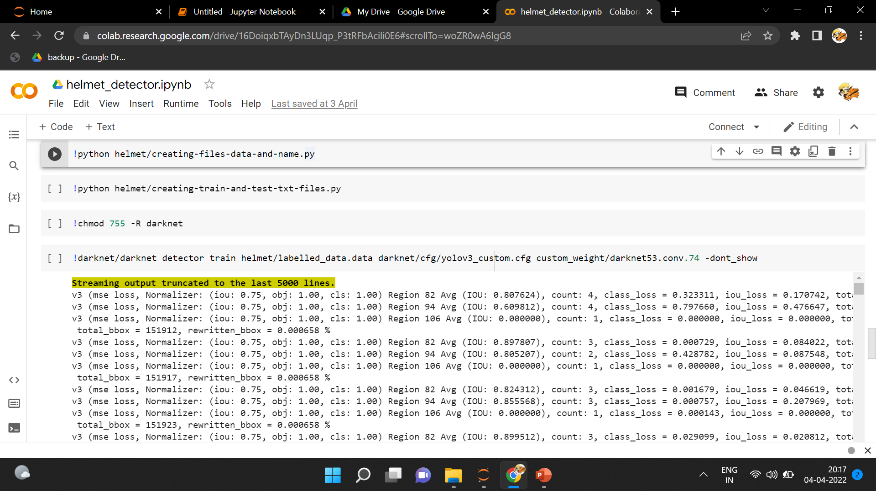

Slide 22


Slide 23
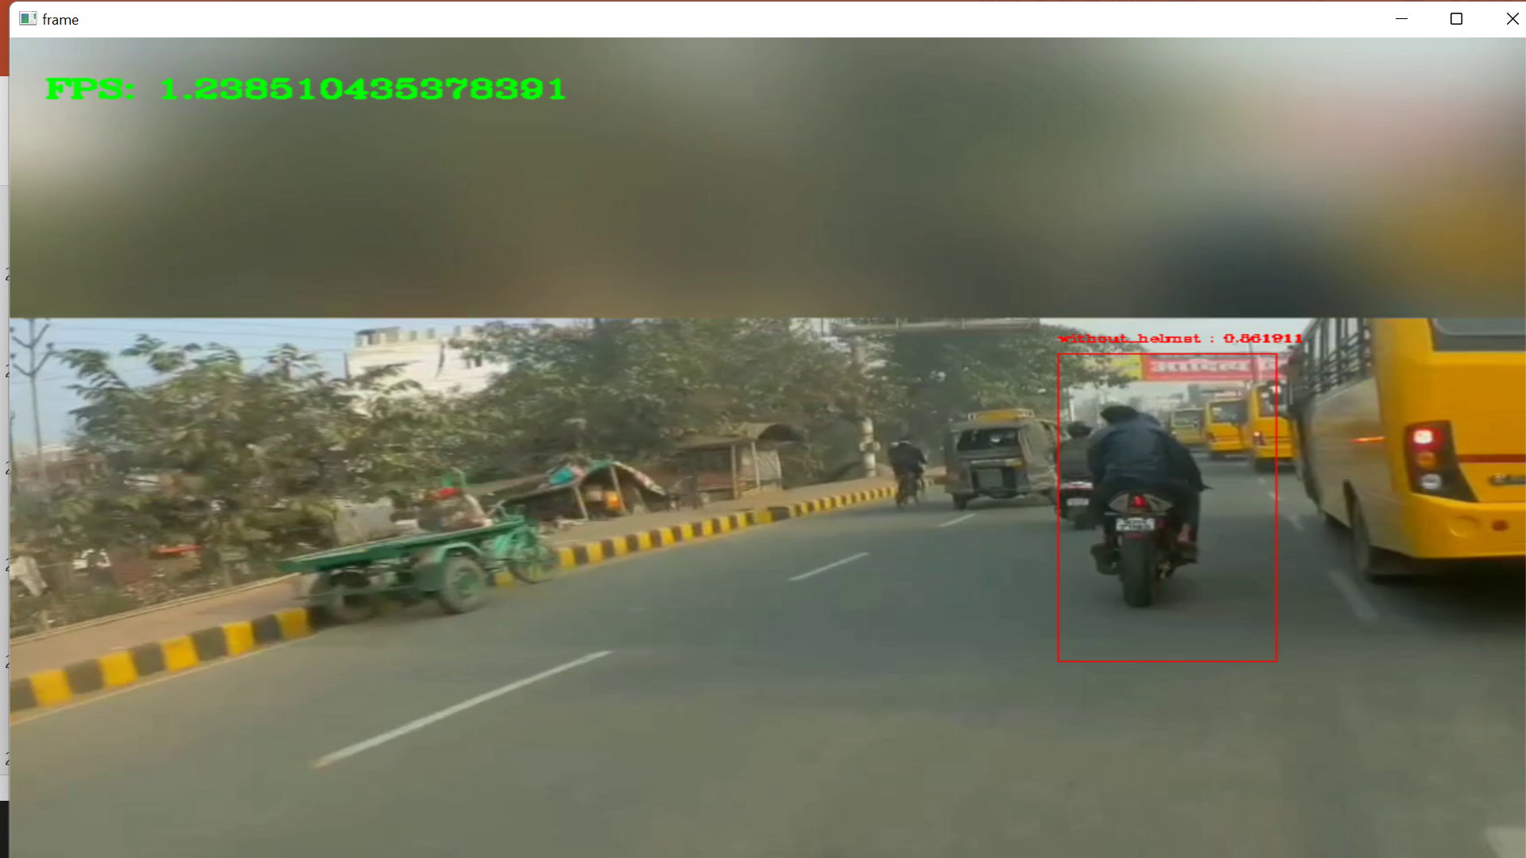

Slide 24
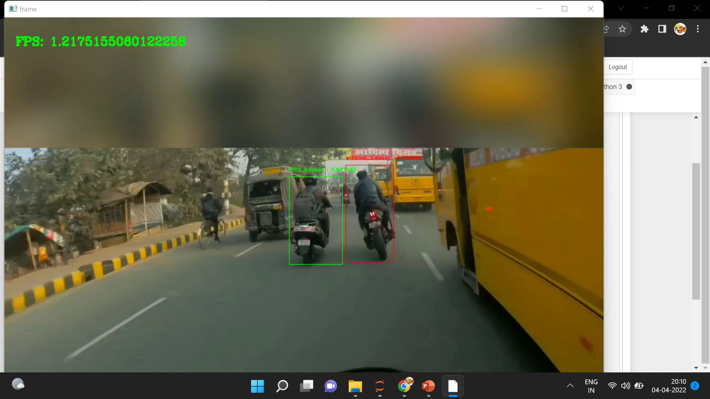

Slide 25
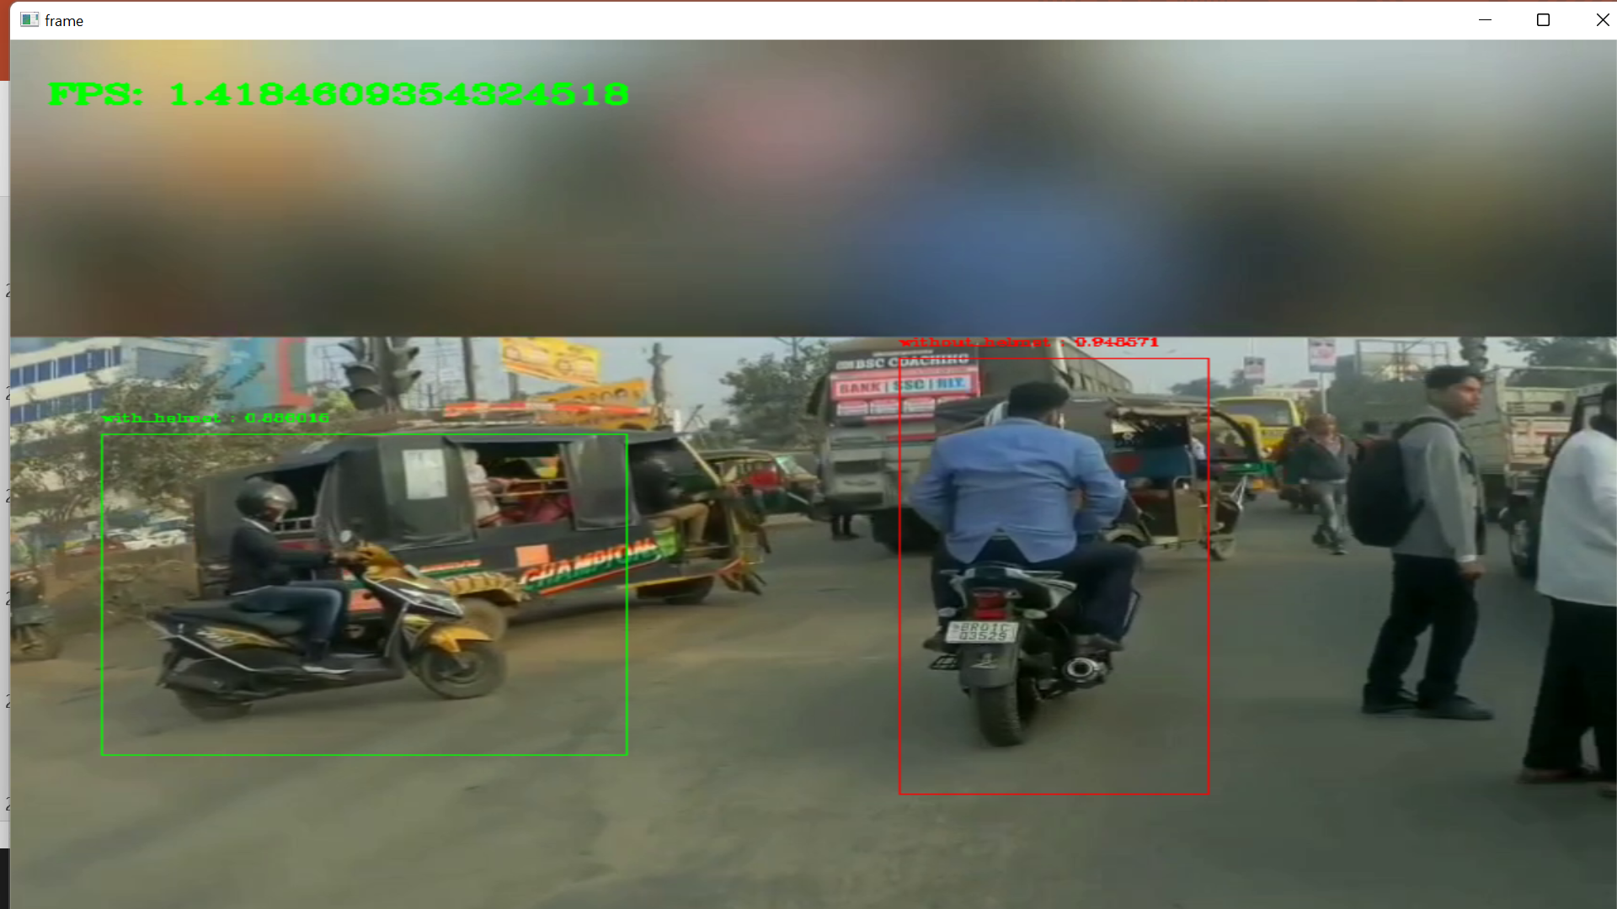

Slide 26
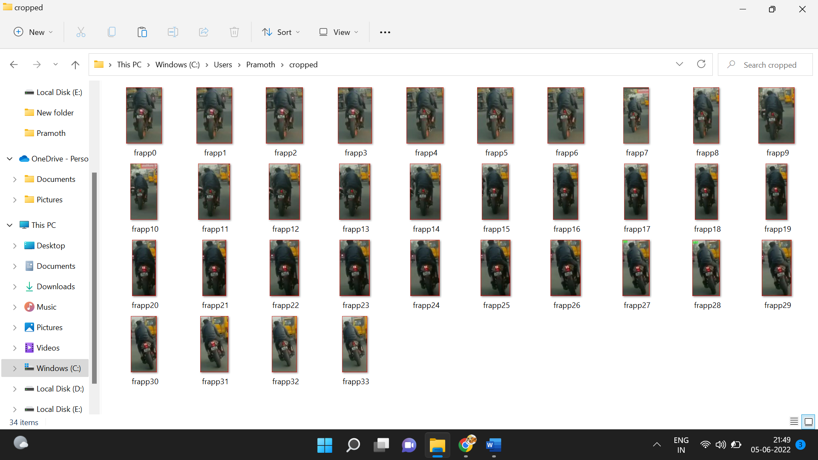

Slide 27
Social Impacts:
Enforce helmet wearing using CCTV cameras.
Helps law requirement by police.
Diminishes the number of mishaps and accidents.
Reduce the usage of human power.
Useful to cities with a huge population.

Slide 28
References:
Prasad, M. V. D., et al. "Detection of two wheelers helmet using machine learning." Turkish Journal of Physiotherapy and Rehabilitation 32 (2021).
Keerthi, K. V. L., et al. "Automatic Recognition of Helmetless Bike Rider License Plate Using Deep Learning." Computational Vision and Bio-Inspired Computing. Springer, Singapore, 2021. 457-467.
Zhou, Fangbo, Huailin Zhao, and Zhen Nie. "Safety Helmet Detection Based on YOLOv5." 2021 IEEE International Conference on Power Electronics, Computer Applications (ICPECA). IEEE, 2021.
Eliyas, Sherin, et al. "Helmet, Violation, Detection Using Deep Learning." European Journal of Molecular & Clinical Medicine 7.2 (2020): 5173-5178.
Lin, Hanhe, et al. "Helmet Use Detection of Tracked Motorcycles Using CNN-Based Multi-Task Learning." IEEE Access 8 (2020): 162073-162084.

Slide 29
Roopa, Y. Mohana, et al. "Convolutional Neural Network-based Automatic Extraction and Fine Generation." 2020 Second International Conference on Inventive Research in Computing Applications (ICIRCA). IEEE, 2020.
Allamki, Lokesh, et al. "Helmet detection using machine learning and automatic License Plate Recognition." International Research Journal of Engineering and Technology (IRJET) 6.12 (2019).
Rohith C A, Shilpa A Nair, Parvathi Sanil Nair, Sneha Alphonsa, Nithin Prince John, “An Efficient Helmet Detection for MVD using Deep learning”, Proceedings of the Third International Conference on Trends in Electronics and Informatics (ICOEI 2019), IEEE Xplore Part Number: CFP19J32-ART; ISBN: 978-1-5386-9439-8.
e Silva, Romuere RV, Kelson RT Aires, and Rodrigo de MS Veras. "Detection of helmets on motorcyclists." Multimedia Tools and Applications 77.5 (2018): 5659-5683.
e Silva, Romuere Rodrigues Veloso, Kelson Rômulo Teixeira Aires, and Rodrigo de Melo Souza Veras. "Helmet detection on motorcyclists using image descriptors and classifiers." 2014 27th SIBGRAPI Conference on Graphics, Patterns and Images. IEEE, 2018.

Slide 30
Ghonge, Sneha A., and Jignyasa B. Sanghavi. "Smart surveillance system for automatic detection of license plate number of motorcyclists without helmet." Int. J. Comput. Sci. Eng 2.1 (2018).
Narong Boonsirisumpun, Wichai Puarungroj, Phonratichi Wairotchanaphuttha, “Automatic Detector for Bikers with no Helmet using Deep Learning”, In Proceedings of the IEEE Conference on Computer 2018 Vision and Pattern Recognition (pp. 2818-2826).
Pathasu Doungmala, Katanyoo Klubsuwan, “Half and Full Helmet Wearing Detection in Thailand using Haar Like Feature and Circle Hough Transform on Image Processing”, In Proceedings of the IEEE 2016 International Conference on Computer and Information Technology.
Dahiya, Kunal, Dinesh Singh, and C. Krishna Mohan. "Automatic detection of bike-riders without helmet using surveillance videos in real-time." 2016 International Joint Conference on Neural Networks (IJCNN). IEEE, 2016.

Slide 31
Thank you

